Slide 1

4D4Life
WP 6 Task 6.0:
Establish Development and Documentation Infrastructure
(and AC2009 –done!)
Wouter Addink, ETI BioInformatics
Design Team meeting, Reading, June 16 2009

Slide 2
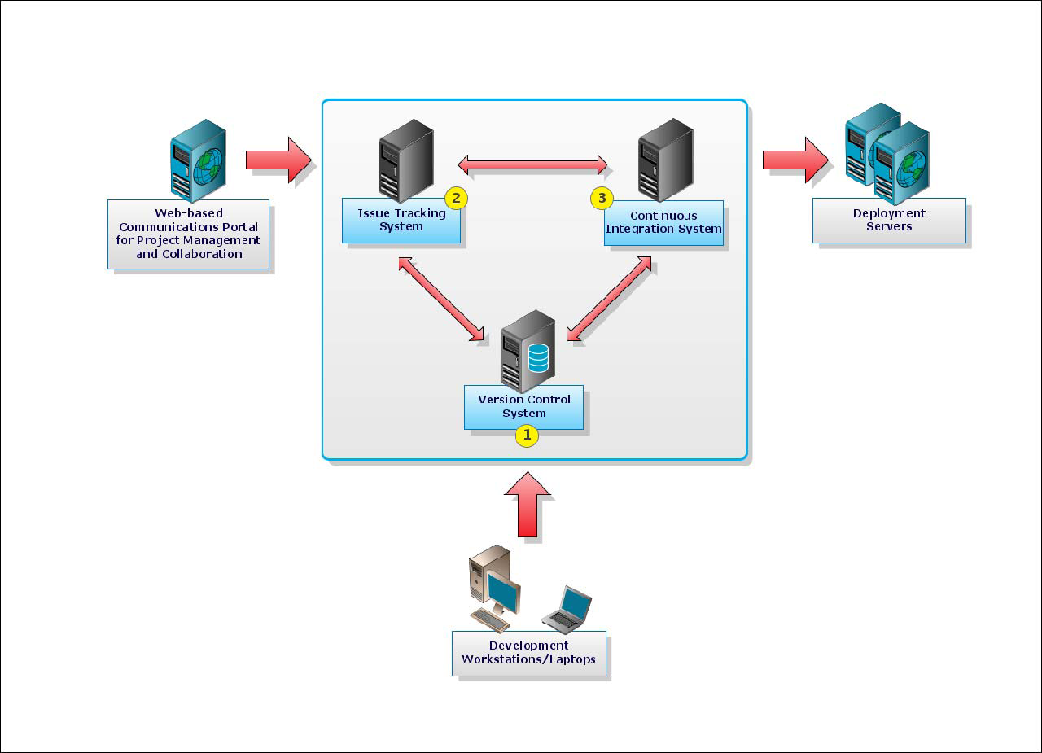
4D4Life
Design Team meeting, Reading, June 16 2009

Slide 3
4D4Life
1. Version Control System
Repository for software source code
To maintain versions + change-logs
Allows for parallel development of code (branches)
Enables possibility for team development
Subversion (SVN) is a modern version control system with a central repository, ‘commit’-based versioning, versioning of directories, widely used, free, well integrated with many development tools.
To allow external use of code, a code browsing tool is recommended (ViewVC or WebSVN)
Existing code should be stored as soon as possible.
Design Team meeting, Reading, June 16 2009

Slide 4
4D4Life
2. Issue Tracking System
System to keep track of issues during development
Issues can be tasks
Issues can be bugs (reporting system included)
Helps Quality Assurance
JIRA is a feature-rich well-known commercial system (not free)
TRAC is a lightweight open source alternative
Both have good integration with SVN
Design Team meeting, Reading, June 16 2009

Slide 5
4D4Life
3. Continuous Integration Tool
Allows modern programming techniques
Automatic building and testing of applications at time or version intervals
Reduces the risk of integration issues appearing late in the project
Improves communication between team members
Reduces the time needed to prepare a release
Allows integration of tools like code documentors
CruiseControl is a Java-based framework for a continuous build process.
A Continuous Integration Tool needs a build system like Ant or Phing
Design Team meeting, Reading, June 16 2009

Slide 6
4D4Life
Communications Portal
For communication between developers and other project members
For project management (centralized information about tools, releases, documentation)
Features can be:
Descriptions of (tool development) projects
Tasks, Milestones, Events
Documents and Files
Discussions/ Forum
Role-based permissions
When Communications portal is ready, we should store existing documentation in the portal
Design Team meeting, Reading, June 16 2009

Slide 7
4D4Life
Testing/Staging and Deployment Server
Should be identical systems
Identical maintenance
Testing server at ETI and Deployment server at Reading?
Development cycles: two week code sprints?
Client is responsible for (black box) testing and acceptance
Unit testing and Stress/load testing (by developers) can be included in development if needed.
Design Team meeting, Reading, June 16 2009

Slide 8
4D4Life
Deployment
Developer (ETI):
Initial installation on production site
Responsible for code updates
Maintainer (Reading):
Responsible for administering
Hosts the applications
Design Team meeting, Reading, June 16 2009

Slide 9
4D4Life
Typical development phases
Inception (one iteration)
Identify and document initial requirement, risks, scope, technical approach. Collect existing code and documentation. Results in a initial project document.
Elaboration (two iterations)
Requirements baseline and architectural baseline are set and tested with prototype. Initial user stories are written down Iterations are planned (based on sorting user stories by ‘risk’: impact on architecture) and agreed on. First development. Result is a prototype confirming architectural decisions enabling initial feedback from client, updated project document.
Construction (enough iterations to get the job done)
will result in Alpha and Beta release, Alpha testing will be completed by phase end.
Transition (one iteration)
Results in a release 1.0 deployed, accepted by client and in production. All documentation and training completed.
(one iteration= approx. two weeks)
Design Team meeting, Reading, June 16 2009

Slide 10
4D4Life
Next tasks:
New base schema (with Design Team)
Enhanced AC and DC Software
SPICE enhancements
Design Team meeting, Reading, June 16 2009

